Slide 1
SHOPPING CART

Slide 2
Objective:
Development of a robust shopping cart system to manage e-commerce tasks effectively. The system will track all tasks and progress related to the shopping cart functionalities, including user experience, backend processes, and integration with payment systems.
Benefits:
Streamlined e-commerce operations.
Enhanced user shopping experience.
Improved inventory and payment management.
Real-time progress tracking for development tasks

Slide 3
Data Sharing Agreement :
Sample File Name: (e.g., shoppingCart_12062024_113045)
Date Stamp Length: 8 digits.
Time Stamp Length: 6 digits.
Number of Columns: Pre-defined in schema.
Column Names: Provided in schema.
Column Data Type: Defined for each column.

Slide 4
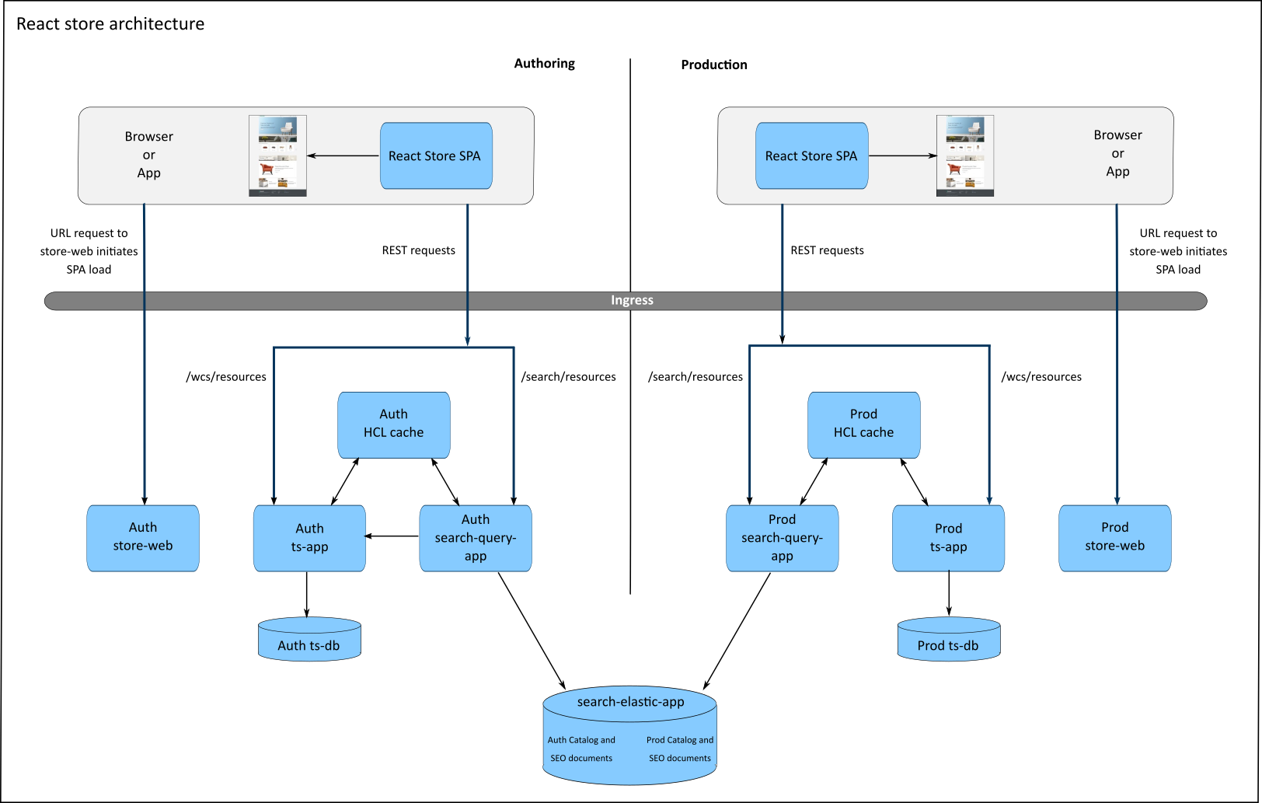
Architecture

Slide 5
Task Validation and Transformation :
Task Naming Validation:
Validate task names using a predefined pattern.
Ensure tasks are organized based on priority and status (e.g., "To-Do", "In Progress", "Completed").
Date and Time Validation:
Tasks are timestamped for proper tracking and scheduling.
Data Type Validation:
Ensure correct data types are used for task descriptions, deadlines, and statuses.
Incomplete or Invalid Tasks:
Tasks missing essential details are flagged and moved to the "Incomplete Tasks" folder.

Slide 6
Data Insertion in Database:
Table creation :- Create a table named t_shoppingCart_tasks to store task-related details.
Task Insertion :- Insert valid tasks into the table. Invalid tasks are flagged for review and logged.

Slide 7
Task Process Tracking:
Export Data :
Export task data in CSV format for tracking.
Process Updates:
Monitor task statuses and deadlines.
Validate the progress of each task.

Slide 8
Development Phases:
Feature Implementation:
Frontend:
Implement an intuitive user interface for cart functionalities (e.g., add/remove items, apply coupons).
Ensure mobile and desktop compatibility.
Backend:
Create APIs for cart operations.
Integrate payment gateways and manage sessions.
Database:
Maintain product inventory, user carts, and transaction logs.

Slide 9
Testing and Debugging:
Testing Files:
Validate the system using pre-defined scenarios and real-time user flows.
Perform stress testing and regression testing.
Debugging Logs:
Maintain detailed logs for each error encountered during development.

Slide 10
Deployment Stages:
Environment Preparation:
Deploy on staging environments for internal testing (e.g., SIT, UAT).
Production Deployment:
After approval, deploy to the live environment.

Slide 11
Q&A Section:
Q1: What type of tasks are tracked?
Development, testing, and deployment tasks.
Q2: How are incomplete tasks handled?
Incomplete tasks are flagged and moved to a separate review list.
Q3: What validation techniques are used?
Task name validation, timestamp validation, and status tracking.
Q4: How is progress monitored?
Regular updates on task statuses and deadlines using a database-driven approach.

